Slide 1
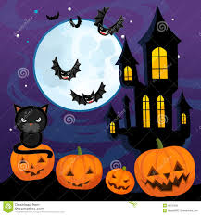

Oidhche Shamhna
Notes:
Hallowe’en

Slide 2
peapag
Notes:
A pumpkin

Slide 3
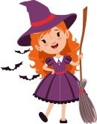
bana-bhuidseach
Notes:
A witch

Slide 4
sguab
Notes:
A broom

Slide 5
ad bhiorach
Notes:
A pointy hat

Slide 6
cat dubh
Notes:
A black cat

Slide 7
ialtag
Notes:
A bat

Slide 8
damhan-allaidh
Notes:
A spider

Slide 9
caisteal
Notes:
A castle

Slide 10
ubhal
Notes:
An apple

Slide 11
ùbhlan
Notes:
apples

Slide 12

a’ ghealach
Notes:
The moon

